Slide 1
ECEG-5193: Algorithm Analysis and Design
Analysis of Sorting and Searching algorithms
Binary Search Trees

Slide 2
Some data structures for storing objects like (aka, nodes with keys)
5
(Sorted) arrays:
Linked lists:
Some basic operations:
INSERT, DELETE, SEARCH
1
2
3
4
5
7
8
3
2
1
8
5
7
4
HEAD

Slide 3
Sorted Arrays
1
2
3
4
5
7
8
O(n) INSERT/DELETE:
First, find the relevant element (we’ll see how below), and then move a bunch elements in the array:
O(log(n)) SEARCH:
1
2
3
4
4.5
8
5
7
eg, insert 4.5
1
2
3
4
5
7
8
eg, Binary search to see if 3 is in A.

Slide 4
(Not necessarily sorted) Linked lists
7
5
3
4
1
2
8
O(1) INSERT:
O(n) SEARCH/DELETE:
eg, insert 6
7
5
3
4
1
2
8
HEAD
6
7
5
3
4
1
2
8
HEAD
eg, search for 1 (and then you could delete it by manipulating pointers).

Slide 5
Motivation for Binary Search Trees
 | Sorted Arrays | Linked Lists | Balanced Binary Search Trees
Search | O(log(n)) | O(n) | O(log(n))
Delete | O(n) | O(n) | O(log(n))
Insert | O(n) | O(1) | O(log(n))

Slide 6
Binary tree terminology
This is a node.
It has a key (7).
Each node has two children.
This node is the root
The left child of is
5
3
2
The right child of is
3
4
3
7
5
The parent of is
3
2
5
is a descendant of
2
4
8
Each node has a pointer to its left child, right child, and parent.
1
Both children of are NIL.
(I won’t usually draw them).
1
These nodes are leaves.
The height of this tree is 3. (Max number of edges from the root to a leaf).
NIL
NIL

Slide 7
Binary Search Trees
A BST is a binary tree so that:
Every LEFT descendant of a node has key less than that node.
Every RIGHT descendant of a node has key larger than that node.
Example of building a binary search tree:
3
4
5
8
7
1
2

Slide 8
Binary Search Trees
A BST is a binary tree so that:
Every LEFT descendant of a node has key less than that node.
Every RIGHT descendant of a node has key larger than that node.
Example of building a binary search tree:
3
4
5
8
7
1
2

Slide 9
Binary Search Trees
A BST is a binary tree so that:
Every LEFT descendant of a node has key less than that node.
Every RIGHT descendant of a node has key larger than that node.
Example of building a binary search tree:
5
3
1
4
7
2
8

Slide 10
Binary Search Trees
A BST is a binary tree so that:
Every LEFT descendant of a node has key less than that node.
Every RIGHT descendant of a node has key larger than that node.
Example of building a binary search tree:
5
3
7
1
2
4
8

Slide 11
Binary Search Trees
A BST is a binary tree so that:
Every LEFT descendant of a node has key less than that node.
Every RIGHT descendant of a node has key larger than that node.
Example of building a binary search tree:
5
Q: Is this the only binary search tree I could possibly build with these values?
3
7
A: No. I made choices about which nodes to choose when. Any choices would have been fine.
2
4
8
1

Slide 12
this should look familiar
kinda like QuickSort
3
4
5
8
7
1
2

Slide 13
Binary Search Trees
Which of these is a BST?
A BST is a binary tree so that:
Every LEFT descendant of a node has key less than that node.
Every RIGHT descendant of a node has key larger than that node.
5
5
3
7
3
7
2
4
8
2
4
8
NOT a Binary Search Tree
1
Binary Search Tree
1

Slide 14
TreeSort
Output all the elements in sorted order!
Traverse:
InOrder Traversal

Slide 15
In-Order Traversal of BSTs
Output all the elements in sorted order!
inOrderTraversal(x):
if x!= NIL:
inOrderTraversal( x.left )
print( x.key )
inOrderTraversal( x.right )
5
3
7
2
4

Slide 16
In-Order Traversal of BSTs
Output all the elements in sorted order!
inOrderTraversal(x):
if x!= NIL:
inOrderTraversal( x.left )
print( x.key )
inOrderTraversal( x.right )
5
3
7
2
4

Slide 17
In-Order Traversal of BSTs
Output all the elements in sorted order!
inOrderTraversal(x):
if x!= NIL:
inOrderTraversal( x.left )
print( x.key )
inOrderTraversal( x.right )
5
3
7
2
4
NIL
NIL

Slide 18
In-Order Traversal of BSTs
Output all the elements in sorted order!
inOrderTraversal(x):
if x!= NIL:
inOrderTraversal( x.left )
print( x.key )
inOrderTraversal( x.right )
5
3
7
2
4
NIL
NIL

Slide 19
In-Order Traversal of BSTs
Output all the elements in sorted order!
inOrderTraversal(x):
if x!= NIL:
inOrderTraversal( x.left )
print( x.key )
inOrderTraversal( x.right )
5
3
7
2
4
NIL
NIL
2

Slide 20
In-Order Traversal of BSTs
Output all the elements in sorted order!
inOrderTraversal(x):
if x!= NIL:
inOrderTraversal( x.left )
print( x.key )
inOrderTraversal( x.right )
5
3
7
2
4
NIL
NIL
2

Slide 21
In-Order Traversal of BSTs
Output all the elements in sorted order!
inOrderTraversal(x):
if x!= NIL:
inOrderTraversal( x.left )
print( x.key )
inOrderTraversal( x.right )
5
3
7
2
4
NIL
NIL
2

Slide 22
In-Order Traversal of BSTs
Output all the elements in sorted order!
inOrderTraversal(x):
if x!= NIL:
inOrderTraversal( x.left )
print( x.key )
inOrderTraversal( x.right )
5
3
7
2
4
2
3

Slide 23
In-Order Traversal of BSTs
Output all the elements in sorted order!
inOrderTraversal(x):
if x!= NIL:
inOrderTraversal( x.left )
print( x.key )
inOrderTraversal( x.right )
5
3
7
2
4
2
3
4

Slide 24
In-Order Traversal of BSTs
Output all the elements in sorted order!
inOrderTraversal(x):
if x!= NIL:
inOrderTraversal( x.left )
print( x.key )
inOrderTraversal( x.right )
5
3
7
2
4
2
3
4

Slide 25
In-Order Traversal of BSTs
Output all the elements in sorted order!
inOrderTraversal(x):
if x!= NIL:
inOrderTraversal( x.left )
print( x.key )
inOrderTraversal( x.right )
5
3
7
2
4
2
3
4
5

Slide 26
In-Order Traversal of BSTs
Output all the elements in sorted order!
inOrderTraversal(x):
if x!= NIL:
inOrderTraversal( x.left )
print( x.key )
inOrderTraversal( x.right )
5
3
7
2
4
2
3
4
5
7

Slide 27
TreeSort Analysis
Inserting an item into a binary search tree:
Worst Case: O(n)
Average Case: O(log₂n)
Inserting n items into a binary search tree:
Worst Case: (1 + 2 + ... + n) O(n²)
Average Case: O(nlog₂n)
Inorder traversal and copy items back into array:
O(n)
TreeSort
Worst Case: O(n²)
Average Case: O(log₂n)
TreeSort makes exactly the same comparisons of keys as QuickSort when the pivot for each sub-list is chosen to be the first key.

Slide 28
In-Order Traversal of BSTs
Output all the elements in sorted order!
inOrderTraversal(x):
if x!= NIL:
inOrderTraversal( x.left )
print( x.key )
inOrderTraversal( x.right )
5
3
7
2
4
Runs in time O(n).
2
3
4
5
7
Sorted!

Slide 29
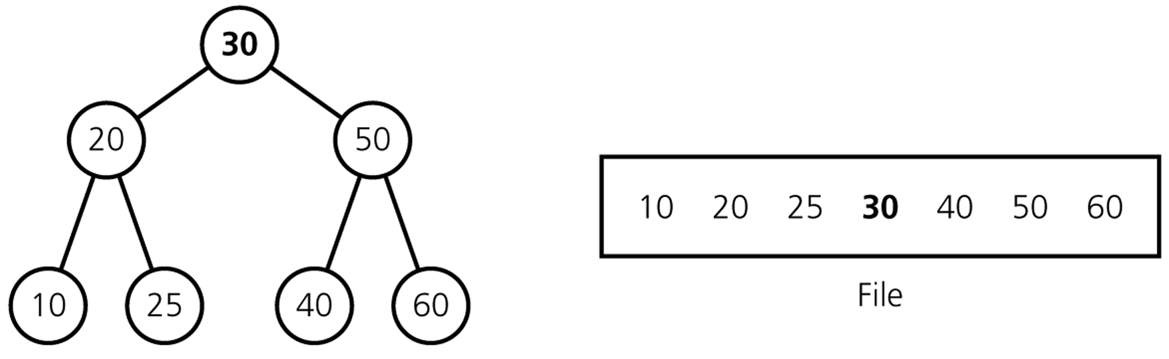
Save a BST to aFile
Save:
Use an InOrder traversal
Save the nodes of the BST into a file.
Save the number of nodes (n)
10 20 25 30 40 50 60
n: 7

Slide 30
Restore a BST File
Restore it to its original shape
Restore:
Read the File
n: 6
10 20 25 30 40 50 60
30
Start with an empty BST.
Put middle element to root
Set its left and right BSTs recursively.

Slide 31
Restore a BST File
Restore it to its original shape
Restore:
Read the File
n: 6
10 20 25 30 40 50 60
30
Start with an empty BST.
Put middle element to root
Set its left and right BSTs recursively.
20
50

Slide 32
Restore a BST File
Restore it to its original shape
Restore:
Read the File
n: 6
10 20 25 30 40 50 60
30
Start with an empty BST.
Put middle element to root
Set its left and right BSTs recursively.
20
50
10
25

Slide 33
Restore a BST File
Restore it to its original shape
Restore:
Read the File
n: 6
10 20 25 30 40 50 60
30
Start with an empty BST.
Put middle element to root
Set its left and right BSTs recursively.
20
50
10
25
40
60

Slide 34
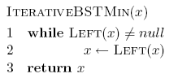
Min/Max
12
8
14
5
9
20

Slide 35
Find Minimum: Recursive Implementation
/**
* method to find the smallest item in a subtree t.
* Return node containing the smallest item.
*/
template <class T>
BinaryNode<T> *
findMin( BinaryNode<T> *t ) const
{
if( t == NULL )
return NULL;
if( t->left == NULL )
return t;
return findMin( t->left );
}

Slide 36
Find Maximum: Non-recursive implementation
/**
*method to find the largest item in a subtree t.
*Return node containing the largest item.
*/
template <class T>
BinaryNode<T> *
findMax( BinaryNode<T> *t ) const
{
if( t != NULL )
while( t->right != NULL )
t = t->right;
return t;
}

Slide 37
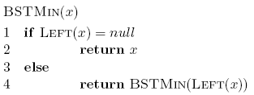
Running time of min/max?
O(height of the tree)

Slide 38
Successor and predecessor
Predecessor(12)?
9
12
8
14
5
9
13
20

Slide 39
Successor and predecessor
Predecessor in general:
Largest node of all those smaller than this node
12
Rightmost element of the left subtree
8
14
5
9
13
20

Slide 40
Successor
Successor(12)?
13
12
8
14
5
9
13
20

Slide 41
Successor
Successor in general?
Smallest node of all those larger than this node
12
Leftmost element of the right subtree
8
14
5
9
13
20

Slide 42
Successor
Successor in general?
Smallest node of all those larger than this node
12
Leftmost element of the right subtree
8
14
What if the node doesn’t have a right subtree?
5
9
13
20

Slide 43
Successor
Successor in general?
Node is the largest
The successor is the node that has x as a predecessor
12
8
14
What if the node doesn’t have a right subtree?
5
9
13
20

Slide 44
Successor
Successor in general?
The successor is the node that has x as a predecessor
12
8
14
5
9
13
20

Slide 45
Successor
Successor in general?
The successor is the node that has x as a predecessor
12
8
14
5
9
13
20

Slide 46
Successor
Successor in general?
Keep going up until we’re no longer a right child
The successor is the node that has x as a predecessor
12
8
14
5
9
13
20

Slide 47
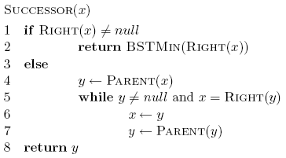
Successor

Slide 48
Successor
if we have a right subtree, return the smallest of the right subtree

Slide 49
Successor
keep going up until we’re no longer a right child

Slide 50
Successor: running time
O(height of the tree)

Slide 51
Fast SEARCH/INSERT/DELETE
Can we do these?

Slide 52
SEARCH in a Binary Search Tree definition by example
EXAMPLE: Search for 4.
5
EXAMPLE: Search for 4.5
It turns out it will be convenient to return 4 in this case
(that is, return the last node before we went off the tree)
3
7
!!!!
2
4
8
1
How long does this take?
O(length of longest path) = O(height)

Slide 53
INSERT in a Binary Search Tree
EXAMPLE: Insert 4.5
5
INSERT(key):
x = SEARCH(key)
Insert a new node with desired key at x…
3
7
!!!!
2
4
8
x =
4
1
4.5

Slide 54
Insert Example
Insert 5
6
2
8
1
4
3
5
What about duplicates?

Slide 55
INSERT in a Binary Search Tree
EXAMPLE: Insert 4.5
5
INSERT(key):
x = SEARCH(key)
if key > x.key:
Make a new node with the correct key, and put it as the right child of x.
if key < x.key:
Make a new node with the correct key, and put it as the left child of x.
if x.key == key:
return
3
7
!!!!
2
4
8
x =
4
1
4.5

Slide 56
DELETE in a Binary Search Tree
EXAMPLE: Delete 2
DELETE(key):
x = SEARCH(key)
if x.key == key:
….delete x….
5
3
7
2
4
8
x =
2
1

Slide 57
DELETE:
Binary Search Tree
THREE CASES

Slide 58
DELETE in a Binary Search Tree
Say we want to delete 3
Case 1: Leaf Node
- 3 is a leaf, just delete it.
5
5
3

Slide 59
DELETE in a Binary Search Tree
Say we want to delete 3
Case 2: The node has one child
- 3 has just one child, move that up.
5
5
3
2
2
This triangle is a cartoon for a subtree

Slide 60
DELETE in a Binary Search Tree
Say we want to delete 3
Case 3: The node has two children
- replace 3 with it’s immediate successor. (aka, next biggest thing after 3)
5
5
3
3.1
2
4
2
4
3.1

Slide 61
DELETE in a Binary Search Tree
Say we want to delete 3
Case 3: The node has two children
- replace 3 with it’s immediate successor. (aka, next biggest thing after 3)
Does this maintain the BST property?
Yes.
How do we find the immediate successor?
SEARCH for 3 in the subtree under 3.right
How do we remove it when we find it?
If [3.1] has 0 or 1 children, do one of the previous cases.
What if [3.1] has two children?
It doesn’t.
5
5
3
3.1
2
4
2
4
3.1

Slide 62
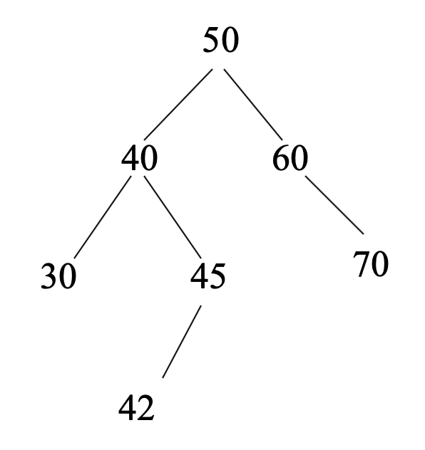
Deletion routine for BST
template <class T>
void remove(const T & x,
BinaryNode<T> * & t ) const
{
if( t == NULL )
return; // Item not found; do nothing
if( x < t->element )
remove( x, t->left );
else if( t->element < x )
remove( x, t->right );
else if( t->left != NULL && t->right != NULL{
t->element = findMin(t->right)->element;
remove(t->element, t->right );
}
else {
BinaryNode<T> *oldNode = t;
t = ( t->left != NULL ) ? t->left : t->right;
delete oldNode;
}
}

Slide 63
How long do these operations take?
SEARCH is the big one.
Everything else just calls SEARCH and then does some small O(1)-time operation.
5
Time = O(height of tree)
3
7
Trees have depth O(log(n)). Done!
2
4
6
8
How long does search take?

Slide 64
Search might take time O(n).
2
This is a valid binary search tree.
The version with n nodes has depth n, not O(log(n)).
3
4
5
6
7
8

Slide 65
Number of BSTs
Suppose we’re inserting n items into an empty binary search tree to create a binary search tree with n nodes,
➔ How many different binary search trees with n nodes, and
What are their probabilities,
There are n! different orderings of n keys.
But how many different binary search trees with n nodes?
n = 0 ➔ 1 BST (empty tree)
n = 1 ➔ 1 BST (a binary tree with a single node)
n = 2 ➔ 2 BSTs
n = 3 ➔ 5 BSTs

Slide 66
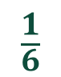
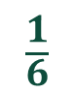
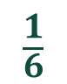
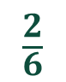
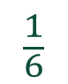
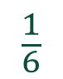
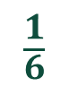
Number of BSTs: Example n = 3
2
1
3
Insertion Order:
3,2,1
3,1,2
2,1,3
2,3,1
1,3,2
1,2,3
3
3
2
2
1
1
2
1
1
3
1
3
3
2
1
2
$$\frac{1}{6}$$
$$\frac{1}{6}$$
2
3
$$\frac{1}{6}$$
$$\frac{1}{6}$$
$$\frac{2}{6}$$
$$\frac{1}{6}$$
$$\frac{1}{6}$$
Probabilities

Slide 67
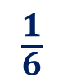
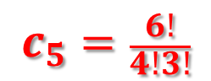
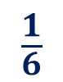
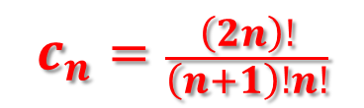
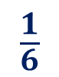
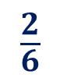

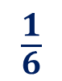
Number of BSTs: Example n = 3
Insertion
Order:
3,2,1
3,1,2
2,1,3
1,3,2
1,2,3
2,3,1
Probability:
$$\frac{1}{6}$$
$$\frac{1}{6}$$
$$\frac{2}{6}$$
$$\frac{1}{6}$$
$$\frac{1}{6}$$
The number of binary search trees that can be made from n elements is given by the n^{th} Catalan Number (denoted C_{n}).
$$c_{5}=\frac{6!}{4!3!}$$
$$c_{n}=\frac{\left(2n\right)!}{\left(n+1\right)!n!}$$
$$c_{5}=5$$

Slide 68
Number of BSTs
We know n = 0 or 1 → count=1.
Consider n = 6 to see the pattern clearly.
1
2
3
6
…
[2,3,4,5,6]
1
[3,4,5,6]
[1,2]
[4,5,6]
[1,2,3,4,5]
Root = 3 case, for instance, creates 2*3 = 6 BSTs (product rule).

Slide 69
Number of BSTs
We know n = 0 or 1 → count=1.
Consider n = 6 to see the pattern clearly.
int nBST(int n)
{
if (n == 0 || n == 1) return 1;
int count = 0;
for i=1; i<=n; i++
count += nBST(i-1) * nBST(n-i); //product rule
return count;
}

Slide 70
Number of BSTs
We know n = 0 or 1 → count=1.
Consider n = 6 to see the pattern clearly.
Speedup by avoiding re-computations via dynamic programming
int nBST(int n, int* results)
{ //results inited to -1s
if (n == 0 || n == 1) return 1;
int count = 0;
for i=1; i<=n; i++
if (results[i-1]==-1) results[i-1] = nBST(i-1);
if (results[n-i]==-1) results[n-i] = nBST(n-i);
count += results[i-1] * results[n-i]; //product rule
return count;
}

Slide 71
Number of BSTs
We know n = 0 or 1 → count=1.
Consider n = 6 to see the pattern clearly.
Speedup by avoiding re-computations via dynamic programming
int nBST(int n) {
results[0] = results[1] = 1;
for i=2; i<=n; i++
results[i] = 0;
for j=0; j<i; j++
results[i] += results[j] * results[i-j-1];//prdct rule
return results[i];
}
//r[5] = r[0]*r[4] + r[1]*r[3] + r[2]*r[2] + r[3]*r[1] + r[4]*r[0] = 42

Slide 72
Search might take time O(n).
2
This is a valid binary search tree.
The version with n nodes has depth n, not O(log(n)).
3
4
5
6
7
8

Slide 73
What to do?
How often is “every so often” in the worst case? It’s actually pretty often!
Goal: Fast SEARCH/INSERT/DELETE
All these things take time O(height)
And the height might be big!!! ☹
Idea 0:
Keep track of how deep the tree is getting.
If it gets too tall, re-do everything from scratch.
At least Ω(n) every so often….
Turns out that’s not a great idea. Instead we turn to…

Slide 74
What if elements are sorted?
2
3
4
5
6
7
8

Slide 75
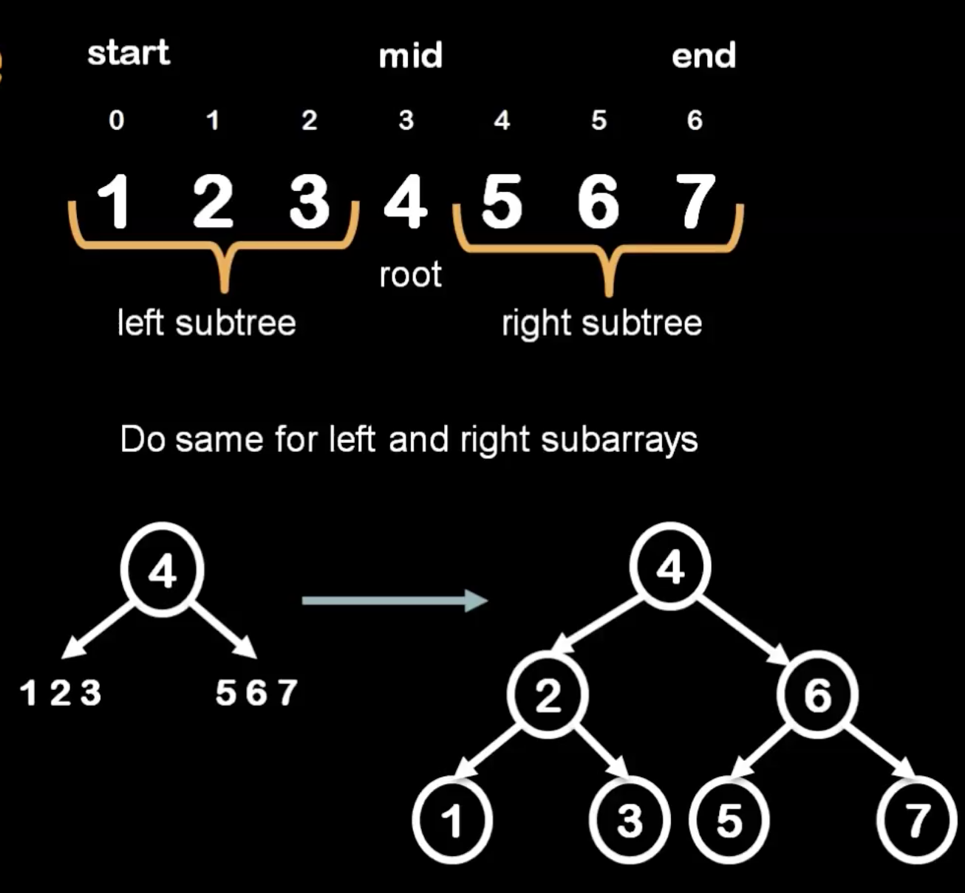
Building a Minimum-Height BST

Slide 76
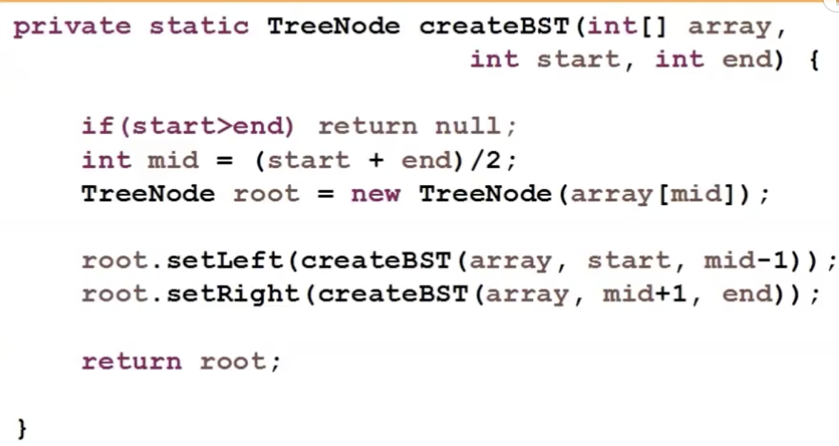
Building a Minimum-Height BST

Slide 77
Self-Balancing Binary Search Trees

Slide 78
Strategy?
Whenever something seems unbalanced, do rotations until it’s okay again.
Even for Lucky this is pretty vague. What do we mean by “seems unbalanced”? What’s “okay”?

Slide 79
Rotations
Whenever something seems unbalanced, do rotations until it’s okay again.

Slide 80
Rotations: Rotate Right
10 6 4 …
10
Grand Parent
6
Parent
4
Node

Slide 81
Rotations: Rotate Right
10 6 4 …
10
Grand Parent
6
Parent
Rotate Right
7
Node

Slide 82
Rotations: Rotate Right
10 6 4 …
6
4
10

Slide 83
Rotations: Rotate Left
4 6 10 …
4
6
10

Slide 84
Rotations
4 10 6 …
Rotate Right
Rotate Left
4
4
6
10
6
4
10
6
10
Notes:
right rotate 10 around 6

Slide 85
Rotations
10 4 6 …
Rotate Left
Rotate Right
10
10
6
4
6
4
10
6
4
Notes:
left rotate 6 around 4

Slide 86
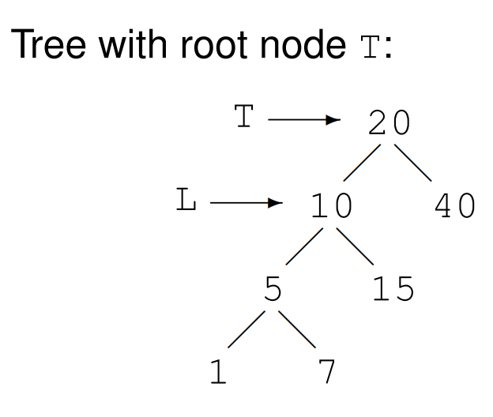
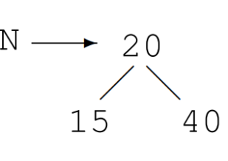
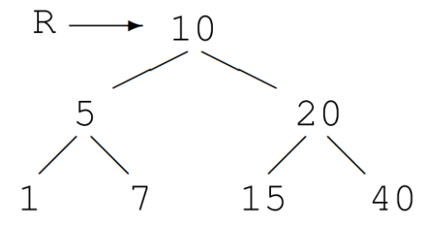
Right Rotations
L is left of T.
New tree N has
right of T as right
right of L as left .
Result R has L as root, the tree N as right, and the left of L as
Notes:
left rotate 6 around 4

Slide 87
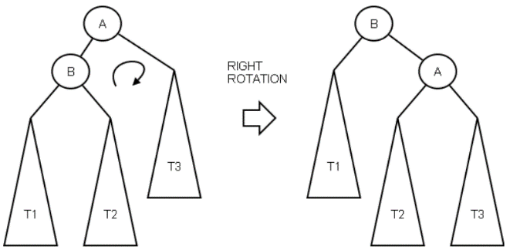
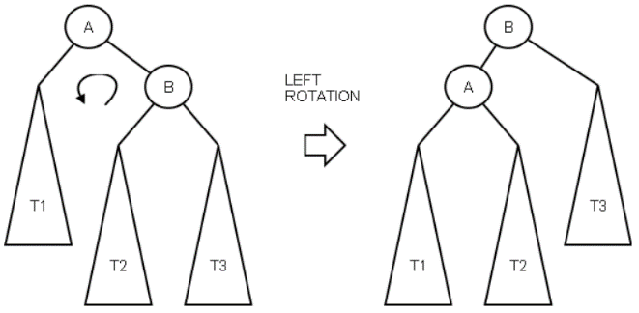
Rotations

Slide 88
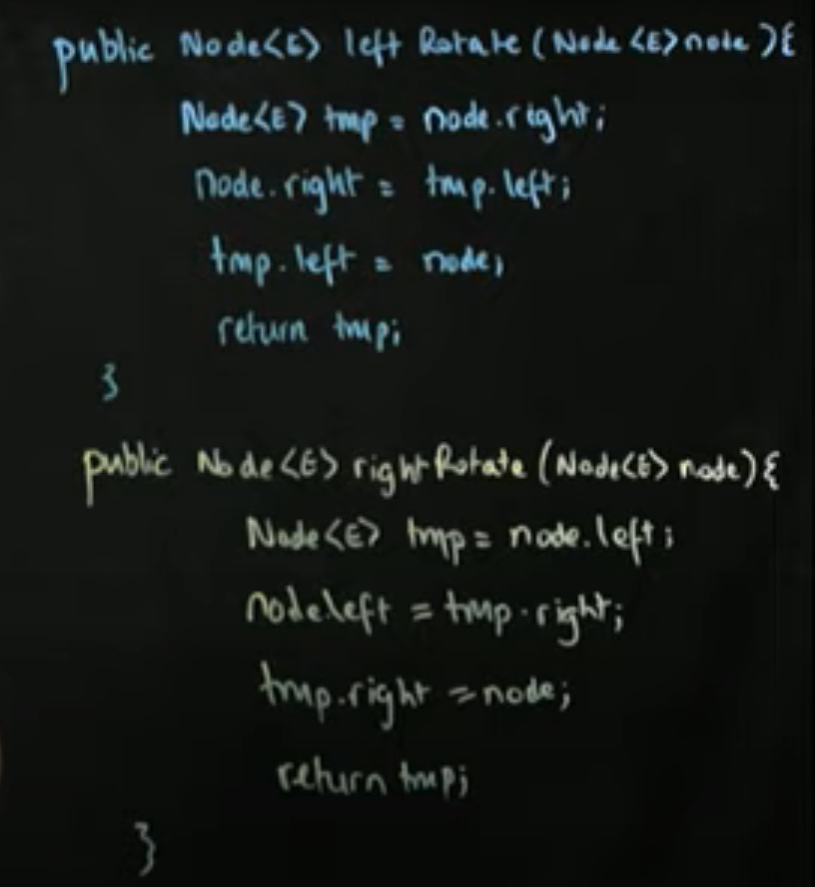
Rotations
Node rotate_left (Node t)
{
Node tmp = t.right;
t.right = tmp.left;
tmp.left = t;
return tmp;
}
t →
4
temp →
6
X
10

Slide 89
Rotations
Node rotate_left (Node t)
{
Node tmp = t.right;
t.right = tmp.left;
tmp.left = t;
return tmp;
}
t →
4
temp →
6
X
10

Slide 90
Rotations
Node rotate_left (Node t)
{
Node tmp = t.right;
t.right = tmp.left;
tmp.left = t;
return tmp;
}
t →
4
X
temp →
6
10

Slide 91
Rotations
Node rotate_left (Node t)
{
Node tmp = t.right;
t.right = tmp.left;
tmp.left = t;
return tmp;
}
temp →
6
4
10
t →
X

Slide 92
Rotations
Node rotate_left (Node t)
{
Node tmp = t.right;
t.right = tmp.left;
tmp.left = t;
return tmp;
}
Analysis
O(1)
Node rotate_right (Node t)
{
Node tmp = t.left;
t.left = temp.right;
tmp.right = t;
return tmp;
}
BUT
How many rotations?

Slide 93
Idea 1: Rotations
No matter what lives underneath A,B,C, this takes time O(1). (Why?)
Maintain Binary Search Tree (BST) property, while moving stuff around.
Note: A, B, C, X, Y are variable names, not the contents of the nodes.
X
Y
Y
Y
C
A
B
X
A
X
A
B
C
B fell down.
B
C
That’s not binary!!
CLAIM:
this still has BST property.

Slide 94
This seems helpful
3
5
2
5
3
7
4
7
2
4
6
8
6
8

Slide 95
Idea 2: have some proxy for balance
Maintaining perfect balance is too hard.
Instead, come up with some proxy for balance:
If the tree satisfies [SOME PROPERTY], then it’s pretty balanced.
We can maintain [SOME PROPERTY] using rotations.
There are actually several ways to do this, but today we’ll see…

Slide 96
Red-Black Trees
A Binary Search Tree that balances itself!
No more time-consuming by-hand balancing!
Red-Black tree!
5
3
7
Maintain balance by stipulating that black nodes are balanced, and that there aren’t too many red nodes.
2
4
6
8

